Slide 1
PROJECT COST MANAGEMENT
Cost Management – Knowledge Area

Slide 2
Project Cost Management
Project Cost Management includes the processes involved in planning, estimating, budgeting, financing, funding, managing, and controlling costs so that the project can be completed within the approved budget.
The Project Cost Management processes are:
Plan Cost Management—The process of defining how the project costs will be estimated, budgeted, managed, monitored, and controlled.
Estimate Costs—The process of developing an approximation of the monetary resources needed to complete project work.
Determine Budget—The process of aggregating the estimated costs of individual activities or work packages to establish an authorized cost baseline.
Control Costs—The process of monitoring the status of the project to update the project costs and manage changes to the cost baseline.

Slide 3
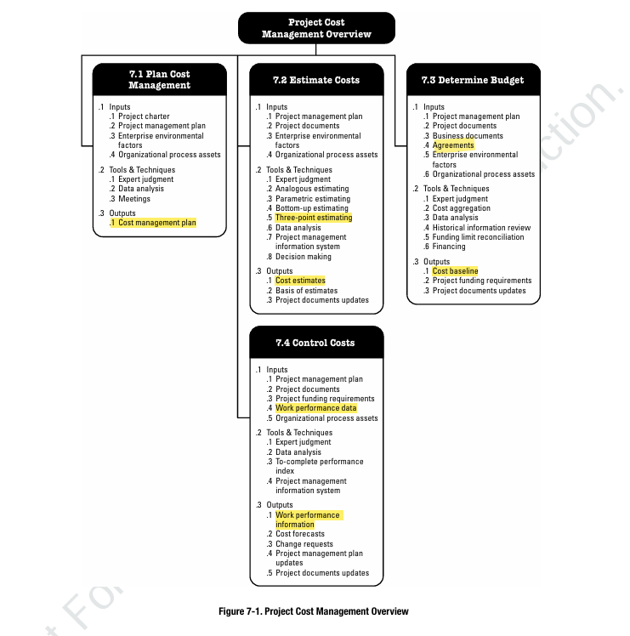

Slide 4
Plan Cost Management
Cost Management Plan:
The cost management plan is a component of the project management plan and describes how the project costs will be planned, structured, and controlled.
Units of Measures.
Level of Precision
Organization Procedures link: The WBS component used for the project cost accounting is called the control account. Each control account is assigned a unique code or account number(s) that links directly to the performing organization’s accounting system.
Rules of Performance Measurements: Earned value management (EVM) rules of performance measurement are set.
Reporting formats: The formats and frequency for the various cost reports are defined.
Additional Details: Procedure to account for fluctuations in currency exchange rates and project cost recording.

Slide 5
Estimate Costs
Analogous Estimating: Analogous cost estimating uses values, or attributes, of a previous project that are similar to the current project. Values and attributes of the projects may include scope, cost, budget, duration, and measures of scale (e.g., size, weight).
Bottom up Estimating: Bottom-up estimating is a method of estimating a component of work. The cost of individual work packages or activities is estimated. The detailed cost is then summarized or “rolled up” to higher levels for subsequent reporting and tracking purposes.
Three Point Estimating: Based on three estimates
Most likely (cM). The cost of the activity, based on realistic effort assessment for the required work and any predicted expenses.
Optimistic (cO). The cost based on analysis of the best-case scenario for the activity.
Pessimistic (cP). The cost based on analysis of the worst-case scenario for the activity.

Slide 6
Estimate Costs
Depending on the assumed distribution of values within the range of the three estimates, the expected cost, cE, can be calculated using a formula.
Two commonly used formulas are triangular and beta distributions.
The formulas are:
Triangular distribution. cE = (cO + cM + cP) / 3
Beta distribution. cE = (cO + 4cM + cP) / 6
Cost estimates based on three points with an assumed distribution provide an expected cost and clarify the range of uncertainty around the expected cost.

Slide 7
Determine Budget
Cost Baseline: The cost baseline is the approved version of the time-phased project budget. It is used as a basis for comparison to actual results.
The cost baseline is developed as a summation of the approved budgets for the different schedule activities.
Work package cost estimates along with contingency reserves/ incidental expense.
For projects that use earned value management, the cost baseline is referred to as the performance measurement baseline.

Slide 8
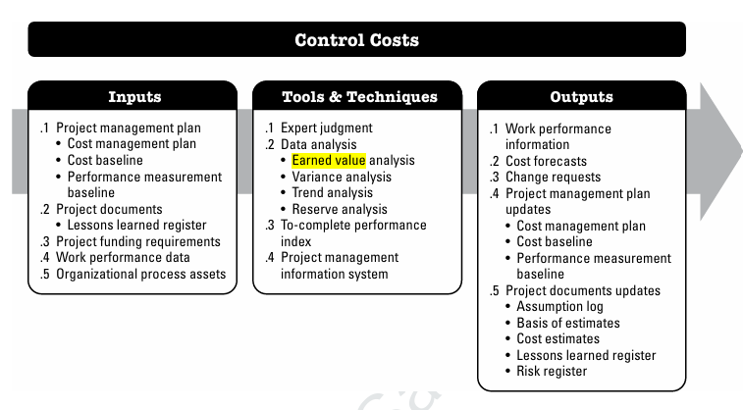
Control Costs
Control Costs is the process of monitoring the status of the project to update the project costs and managing changes to the cost baseline.

Slide 9
Earned Value Management (EVM)/Analysis
Earned value analysis compares the performance measurement baseline to the actual schedule and cost performance.
EVM integrates the scope baseline with the cost baseline and schedule baseline to form the performance measurement baseline.

Slide 10
Earned Value Management Terms
Planned Value (PV)
Planned value (PV) is the authorized budget assigned to scheduled work at a specific time. PV, also known as Budget Cost of Work Scheduled (BCWS).
PV = BAC * Planned % Complete, where BAC is the Budget at Completion, and Planned % Complete is the percentage of planned work completed up to the current reporting period.
Actual Costs (AC)
Actual cost (AC) is the realized cost incurred for the work performed on an activity during a specific time period.
It is also known as actual cost of work performed (ACWP)

Slide 11
Earned Value Management Terms
Earned Value (EV)
(EV) is a measure of work performed expressed in terms of the budget authorized for that work. EV is the quantification of the “worth” of the work done to date. Earned Value is also called Budgeted Cost of Work Performed (BCWP).
EV = BAC * Actual % Complete, where BAC is the Budget at Completion, and Actual % Complete is the percentage of actual work completed up to the current reporting period.
Example:
You’ve made a plan to complete a certain amount of work and budget accordingly. But, from experience, you know that there is bound to be some discrepancy from your estimate. At the end of 2 months, you may have planned to complete 40% of your work, but let’s say you only managed to finish 30%. what’s the budgeted cost for this work?

Slide 12
Earned Value Management Terms
Variance Analysis
Planned value, actual cost, and earned value numbers are vital to variance calculations.
The project manager wants to know how far off we are from the project baseline. This can be determined through schedule and cost variance.
Schedule Variance (SV)
Schedule variance is a quantitative indicator of your divergence from the initial planned schedule.
It is the amount by which the project is ahead or behind the planned delivery date, at a given point in time.
A negative SV indicates that we are behind schedule, a positive SV indicates that we are ahead of schedule and zero means that we are exactly on schedule.
SV = EV – PV

Slide 13
Earned Value Management Terms
Cost Variance (CV)
Cost variance is a quantitative indicator of your divergence from the initial planned budget. A negative CV indicates that we are over budget, a positive CV indicates that we are under budget and zero means that we are exactly on budget.
CV = EV – AC
Performance Indexes
Another analysis that can be done by using EVMS -- Schedule and Cost index.
Schedule Performance Index (SPI) It measures how efficiently the project team is using its time. SPI gives a sense of project performance from a schedule perspective. SPI = EV/PV; SPI > 1 indicates the project is ahead of schedule and SPI < 1 indicates the project is behind schedule.

Slide 14
Earned Value Management Terms
Cost Performance Index (CPI)
The cost performance index (CPI) is a measure of the cost efficiency of budgeted resources. It gives a sense of project performance from a cost perspective.
CPI = EV/AC; CPI > 1 indicates the project is under budget and CPI < 1 indicates the project is over budget.

Slide 15
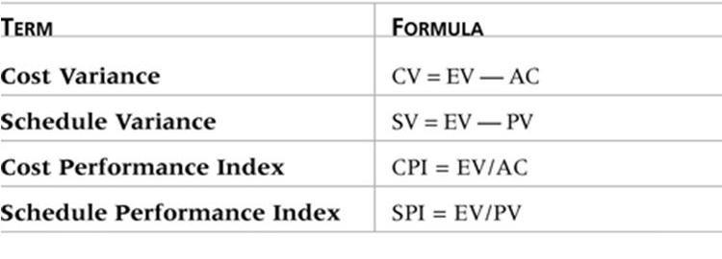
Earned Value Management Formulas

Slide 16
Example
EV = $38,000
AC = $48,000
CV?
CV = EV – AC = $38,000 - $48,000 = -$10,000
The project is over budget.

Slide 17
Example
PV = $42,000
EV = $38,000
SV?
SV = EV – PV = $38,000 - $42,000 = -$4,000
$4000 worth of work is behind schedule

Slide 18
Example
EV = $38,000
AC = $48,000
CPI?
CPI= EV / AC = $38,000 / $48,000 = 0.79
PV = $42,000
EV = $38,000
SPI?
SPI= EV / PV = $38,000 / $42,000 = 0.90

Slide 19
Exercise 1
You are the project manager on a project. The project is expected to be completed in 10 months at a cost of $10,000, or we can say $1000 per month. After 6 months the project is 55% completed and the planned value after 6 months is $6000 and the actual expenditure after 6 months is $6750. Determine the status of project after the 6 months.

Slide 20
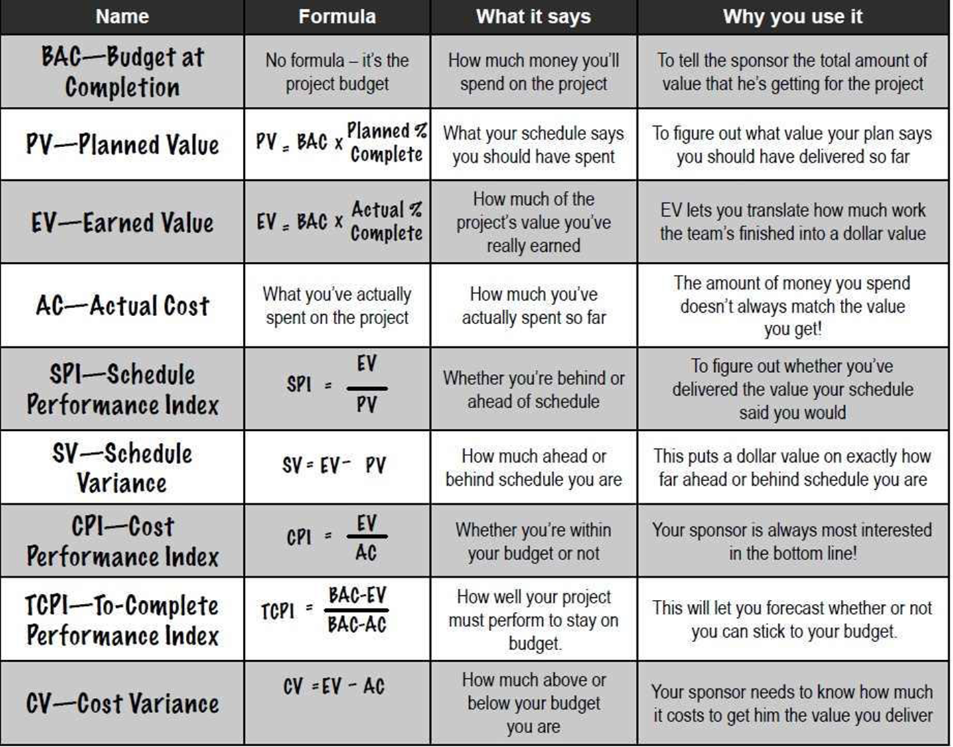
Formulas

Slide 21
Exercise 2
You are the project manager on a project that has a $800,000 software development effort. There are two teams of programmers that will work for six month for a total of 10,000 hours. According to the project schedule your team should be done with 38% of the work. As of today, the project is 40% complete while 50% budget has been used. Calculate and share your conclusion.

